Slide 1

Language Faculty Science 2
Modifying the initial hypothesis
How we obtain experimental results precisely in line with definite predictions under the revised hypothesis (in the spirit of the Guess-Compute-Compare method).

Slide 2
The main general thesis of the language faculty science research is that it is possible to accumulate knowledge about part of the mind (the language faculty) by the basic scientific method (by the “Guess-Compute-Compare method) (so in a way very much as in physics). (This is a remarkable result if true; very few people in the world know/think that that is in fact possible at all!!)
Since the language faculty is internal to an individual, the “Guess-Compute-Compare” method is applied to individuals; hypotheses are about individuals (not about a group of individuals, and experiments are on an individual (not on a group, even when the number of individuals participating in experiments is quite large).
At the “Guess” stage, we adopt Chomsky’s Merge idea. To make the Merge idea testable in line with “Guess-Compute-Compare”, we did two things: (I) define the structural notion of c-command in terms of Merge (A c-commands B = A is merged with something that contains B) and (II) seek to detect effects of c-command by pursuing (i) the hypothesis that some interpretation between two items (such as BVA(X, Y)) is possible only if X-commands Y and (ii) the hypotheses that have consequences about whether or not X c-commands Y in a merge-generated set.

Slide 3
We were in the middle of illustrating this during the last lecture.
Many individuals report that they accept BVA(X, Y) in sentences in which X, according to our hypotheses, does not c-command Y.
Even when we focus on individuals who seem attentive, we do not get the result that no individual accept BVA(X, Y) in sentences in which X, according to our hypotheses, does not c-command Y.
This lecture begins to address how we can obtain experimental results precisely in line with our definite prediction that BVA(X, Y) is impossible in sentences in which X does not c-command Y, according to our hypotheses. The upshot of the lecture is this: if a speaker is attentive, and if a choice of X does not give Quirky (non-c-command-based) effects and if a choice of Y does not give Quirky (non-c-command-based) effects, at a given time, then they necessarily reject BVA(X, Y) with such choices of X and Y when X does not c-command Y, at that time.
For how to identify such choices of X and Y, we turn to two other meaning relations (DR and Coref).

Slide 4
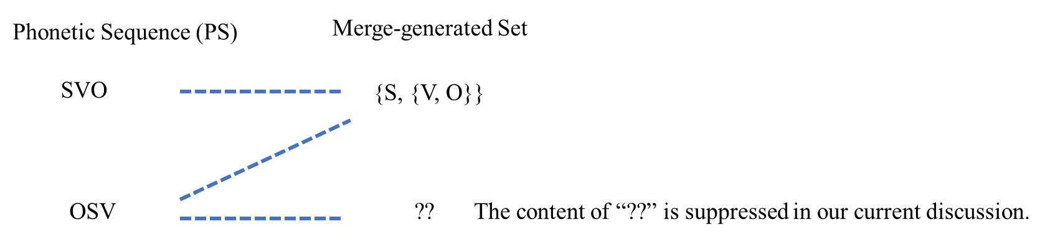
General Hypotheses:
There exists the language faculty.
There exists the Computational System of the language faculty.
The computational system has the set-forming operation “Merge”, as its only structure-building operation.
“C-command”, defined in terms of Merge
A c-commands B
= A is merged with something that contains B.
Specific Hypotheses:

Slide 5

If the possibility of BVA(X, Y) requires X c-commanding Y, we can relate its impossibility to X not c-commanding Y and its possibility to X c-commanding Y.

Slide 6
  The Initial Hypothesis:
  BVA(X, Y) → CC(X, Y)
  (If BVA(X, Y), then necessarily X c-commands Y.)
  (X c-commanding Y is a necessary condition for BVA(X, Y).)
  The above is equivalent to:
  ¬CC(X, Y) → ¬BVA(X, Y)
  (If X does not c-command Y, BVA(X, Y) is not possible.)
Notation
CC(X, Y): X c-commands Y.
P → Q
is equivalent to:
¬Q → ¬P

Slide 7
Since the following discussion refers to on-line “Experiments” and their results, it is necessary to provide information about the on-line “Experiments”. A presentation of the entirety of the on-line “Experiments” will not be attempted here because that would likely hinder an effective presentation of the essentials of LFS within three lectures. I will instead provide what seems to be necessary information about on-line “Experiments” as we proceed.
A presentation of the entirety of the on-line “Experiments”, referred to here, will be provided in a separate file.

Slide 8
One of the on-line “Experiments” contains the three sentences below, with their intended interpretations given in the parentheses, with another set of three sentences where ‘praised’ is replaced by ‘invited’.
(Under the interpretation "Every boy praised his own father")
His father, every boy praised.
(Under the interpretation "Every boy was praised by his own father")
His father praised every boy.
(With His referring to a specific boy, Mike, for example)
His father praised every boy.
One of the on-line “Experiments” contains the three sentences below, with their intended interpretations given in the parentheses, with another set of three sentences where ‘praised’ is replaced by ‘invited’.
“BVA31-37 (BVA(every boy, his)”, “Schema A”, “Schema B”, and “Schema C” are for analyzing the experimental results, and participants in the “Experiments” do not see them.

Slide 9
One of the on-line “Experiments” contains the three sentences below, with their intended interpretations given in the parentheses, with another set of three sentences where ‘praised’ is replaced by ‘invited’.
BVA31-37 (BVA(every boy, his))
Schema A1 (Under the interpretation "Every boy praised his own father")
His father, every boy praised.
Schema B1 (Under the interpretation "Every boy was praised by his own father")
His father praised every boy.
Schema C1 (With His referring to a specific boy, Mike, for example)
His father praised every boy.
Schema A2 (Under the interpretation "Every boy invited his own father")
His father, every boy invited.
Schema B2 (Under the interpretation "Every boy was invited by his own father")
His father invited every boy.
Schema C2 (With His referring to a specific boy, Mike, for example)
His father invited every boy.
(Under the interpretation "Every boy praised his own father")
His father, every boy praised.
(Under the interpretation "Every boy was praised by his own father")
His father praised every boy.
(With His referring to a specific boy, Mike, for example)
His father praised every boy.
“BVA31-37 (BVA(every boy, his)”, “Schema A”, “Schema B”, and “Schema C” are for analyzing the experimental results, and participants in the “Experiments” do not see them.
Participants only see the sentence and the intended interpretation in the parentheses, along with the instructions in the next slide.

Slide 10
Instructions given in on-line “Experiments”
When seeing one example sentence at a time, the instructions are:
If you find the sentence below totally unacceptable under the specified interpretation given in the parentheses, please choose 'x.' If you find it acceptable at least to some extent under the specified interpretation, please choose 'o.'
When seeing a set of three example sentences at a time, the instructions are:
Please compare the three sentences below. For each sentence, please choose 'x' if you find it totally unacceptable under the specified interpretation given in the parentheses, and 'o' if you find it acceptable at least to some extent under the specified interpretation.
The reference to “total unacceptability” is in line with our pursuit of definite experimental results, required by the “Guess-Compute-Compare” method. Without definite experimental results, we cannot compare our definite predictions with our experimental results, making it impossible to carry out the “Compare” part of “Guess-Compute-Compare”.

Slide 11
According to our hypothesis about SVO, every boy in His father praised every boy does not c-command his in the merge-generated set corresponding to this sentence, i.e., {{his father}, {praised, every boy}}.
Likewise, more than one boy in His father praised more than one boy does not c-command his in the merge-generated set corresponding to this sentence, i.e., {{his father}, {praised, more than one boy}}.

Slide 12
We then predict:
BVA(more than one boy, his) is impossible in ‘His father praised more than one boy’
BVA(every boy, his) is impossible in ‘His father praised every boy’.
Many speakers, however, accept the BVA in such sentences.
Speakers who accept such sentences (at least to some extent) with the BVA(X, Y), where X does not c-command Y in their corresponding merge-generating set, even once, are represented in our Venn Diagram as a Red *.
If everything is “good”, no individual should be represented as Red *.

Slide 13
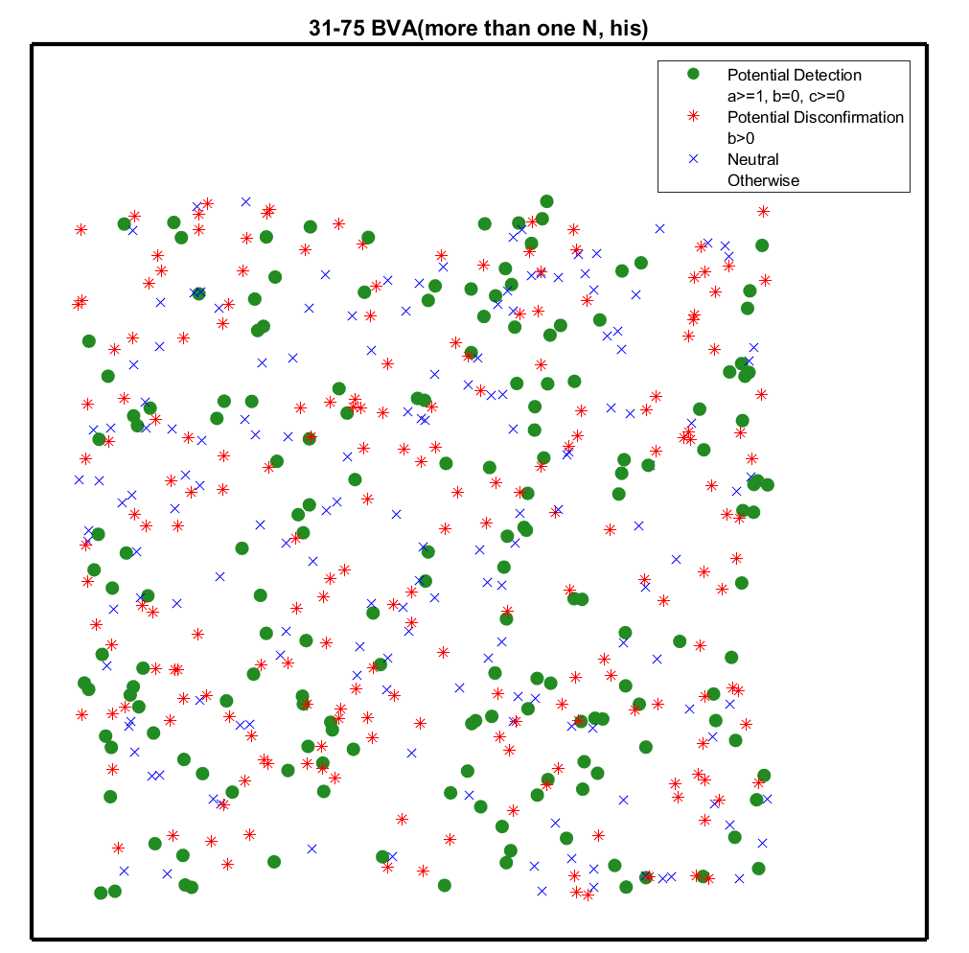

Slide 14
One might wonder if this might be because the speakers are not reliable due to inattentiveness, for example, and suspect that Red *’s will disappear once we focus on reliable speakers.

Slide 15
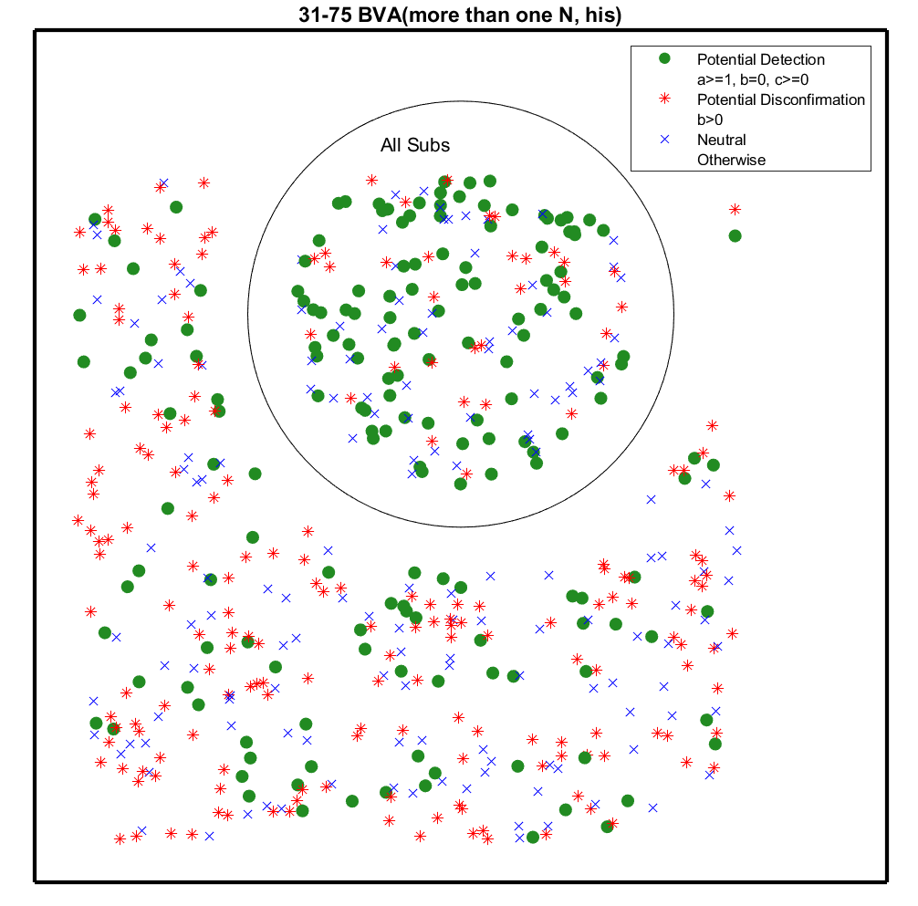




BVA31-75
If a speaker responded, “Acceptable at least to some extent”, even once, on Schema B1 of Top31-48, for example, the speaker is considered as failing the Top31-48 test and is placed outside the “All Subs” Circle.
Top31-48
Schema A1 (Under the interpretation "Mary praised Bill" )
Bill, Mary praised.
Schema B1 (Under the interpretation "Mary praised Bill" )
Bill, Mary praised John.
Schema C1 (Under the interpretation "Mary praised Bill" )
Bill, Mary praised him.
If the speaker never accepts Schema A sentences, like A1, the speaker is also considered as failing the Top31-48 test.
Even if we focus on speakers who have passed all relevant Sub-Experiment tests, we still have many red Red *’s, as seen in the Circle in this diagram.

Slide 16
Another Sub-Experiment
DRInst63-10
Schema A1 (Under the interpretation that the total number of students in question is three)
Two teachers praised three students.
Schema B1 (Under the interpretation that the total number of students in question is three)
Two teachers each praised a different set of three students.
Schema C1 (Under the interpretation that the total number of students in question is six)
Two teachers each praised a different set of three students.
The same criteria for passing and failing the Sub test:
Never accepts Schema B, even once, and accepts Schema A at least once, then Pass.
Accepts Schema B even once or never accepts Schema A, then Fail.

Slide 17




Other Relevant Sub-Experiments
DRLex63-11 (every teacher) (three students vs. those three students)
Schema A1 (Under the interpretation that each teacher in question praised a different set of three students)
Every teacher praised three students.
Schema B1 (Under the interpretation that each teacher in question praised a different set of three students)
Every teacher praised those three students.
Schema C1 (Under the interpretation that each teacher in question praised the same three students)
Every teacher praised those three students.
DRLex63-13 (more than one teacher) (three students vs. those three students)
Schema A1 (Under the interpretation that each teacher in question praised a different set of three students)
More than one teacher praised three students.
Schema B1 (Under the interpretation that each teacher in question praised a different set of three students)
More than one teacher praised those three students.
Schema C1 (Under the interpretation that each teacher in question praised the same three students)
More than one teacher praised those three students.
The same criteria for passing and failing the Sub test:
Never accepts Schema B, even once, and accepts Schema A at least once, then Pass.
Accepts Schema B even once or never accepts Schema A, then Fail.

Slide 18
This is not just with X=more than one N.

Slide 19
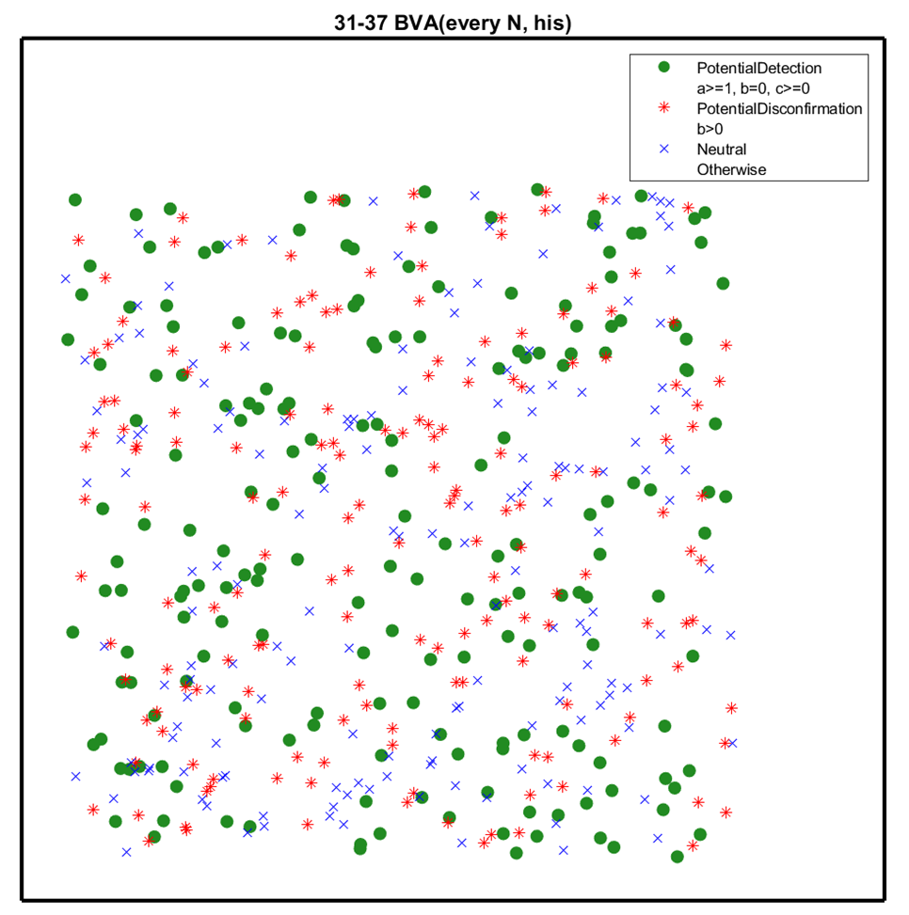
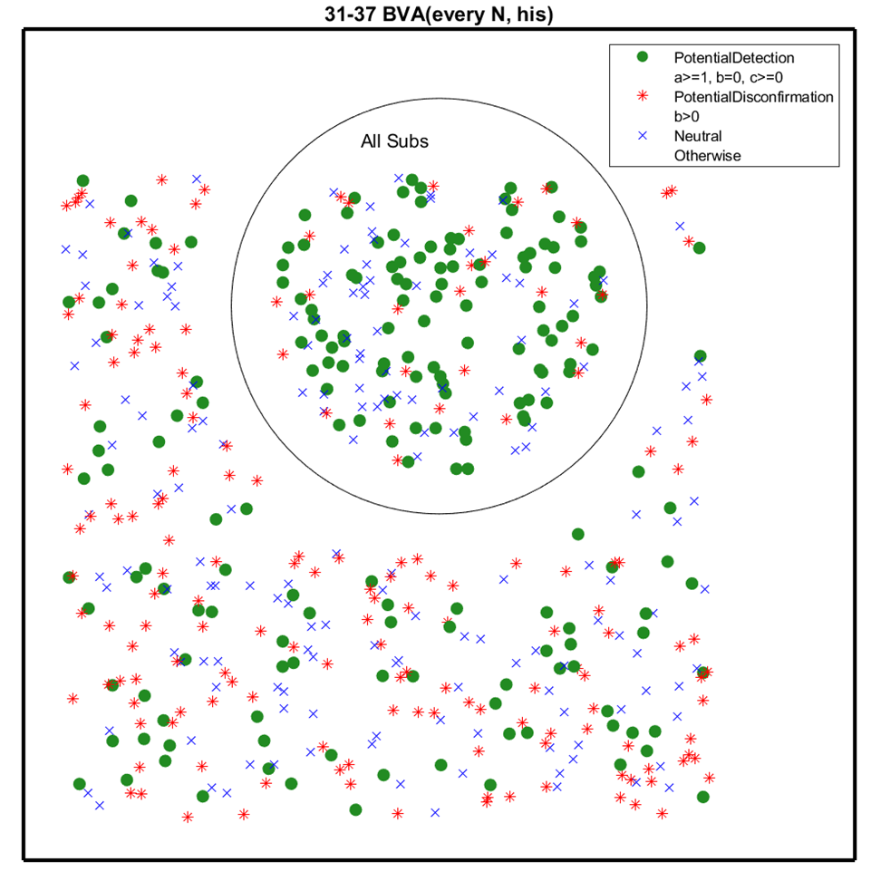
With BVA(every N, his)

Slide 20
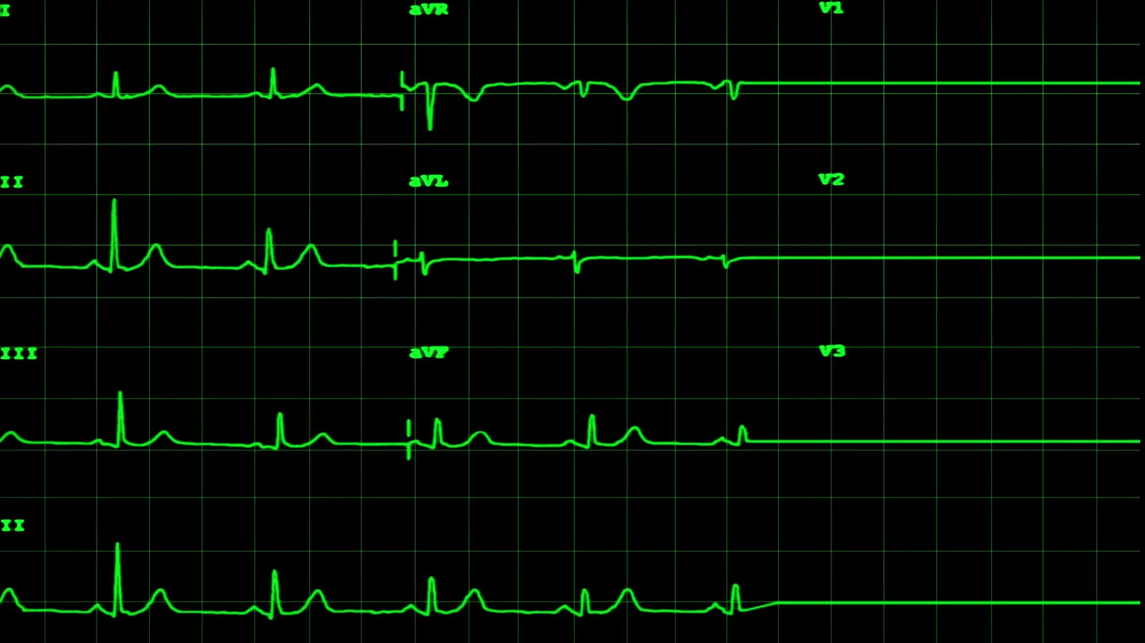
Not particularly surprising, if what affects our judgments (responses to on-line Experiment questions) is not just properties of the CS (e.g., whether X c-commands Y).

Slide 21
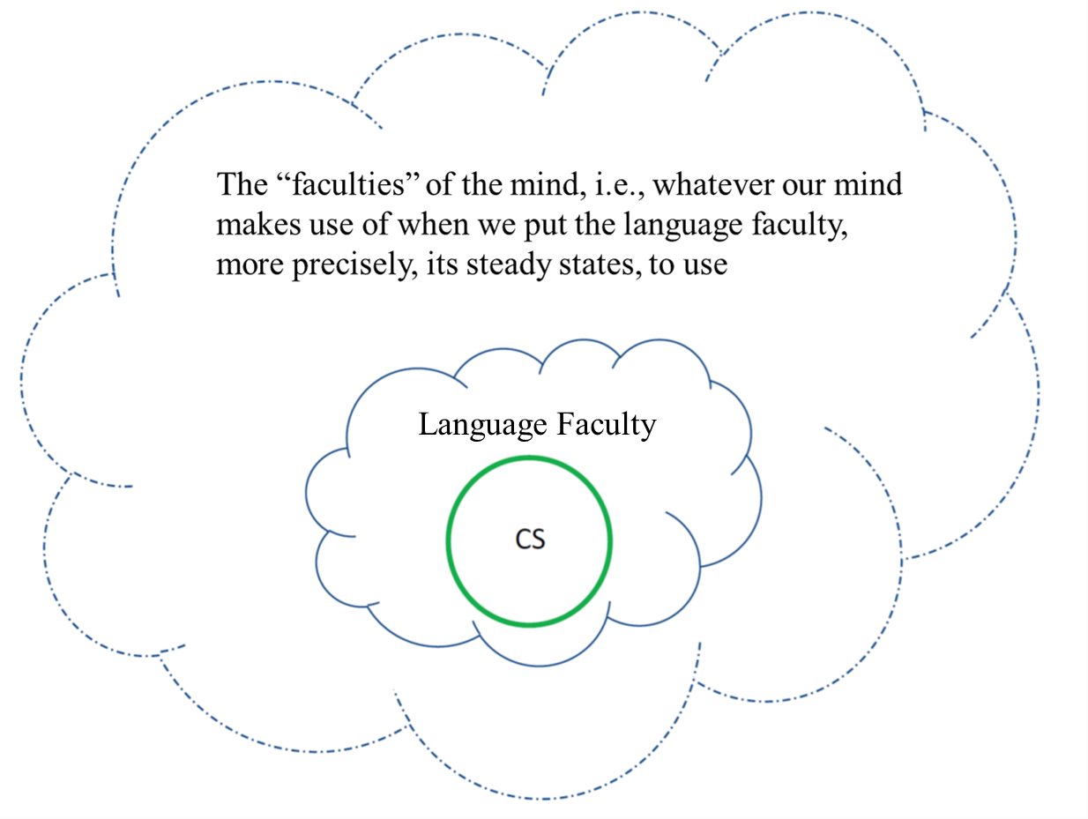



The Computational System (=CS), the language faculty and what is “outside” the language faculty.
This part outside the language faculty contains knowledge about the world, “inference system”, etc. and etc.
Our judgments can be affected not just by properties of the CS (more specifically whether X c-commands Y) but also by “factors” surrounding the CS!
Including judging sentences as acceptable or not, under a specified interpretation as in our on-line Experiments.
The part outside the CS contains the individual’s mental dictionary.

Slide 22
Revised Hypothesis:
There are three sources for BVA(X, Y):
CC(X, Y): X c-commanding Y
XQrk: Quirky (non-c-command-based) source for BVA(X, Y) that is crucially based on the choice of X.
YQrk: Quirky (non-c-command-based) source for BVA(X, Y) that is crucially based on the choice of Y.
To have BVA(X, Y), we must have (i), (ii), or (iii), with the ‘or’ being inclusive.
(i) X c-commands Y
(ii) X is [+XQrk]
(iii) Y is [+YQrk]
BVA(X, Y) → CC(X, Y) ˅ XQrk ˅ YQrk
= ¬(CC(X, Y) ˅ XQrk ˅ YQrk) → ¬BVA(X, Y) (contrapositive of the above)
= ¬CC(X, Y) ˄ ¬XQrk ˄ ¬YQrk → ¬BVA(X, Y) (by De Morgan’s Law)
BVA(X, Y) is not possible if X does not c-command Y, there is no XQrk, and there is no YQrk.

Slide 23
If we can identify X that is [-XQrk] and Y that is [-YQrk], independently of BVA,
we can in effect change:
BVA(X, Y) → CC(X, Y) ˅ XQrk ˅ YQrk
=
¬CC(X, Y) ˄ ¬XQrk ˄ ¬YQrk → ¬BVA(X, Y)
back to:
BVA(X, Y) → CC(X, Y)
=
¬CC(X, Y) → ¬BVA(X, Y)
because, in that case, we have neither XQrk nor YQrk.
And we can now check and see if we observe effects of c-command, focusing on the prediction that ¬CC(X, Y) necessarily results in ¬BVA(X, Y), without exception.

Slide 24
How can we identify X that is [-XQrk] and Y that is [-YQrk], independently of BVA?
We use DR-Mains and Coref-Mains for that purpose.

Slide 25
DR(X, Y)

Slide 26
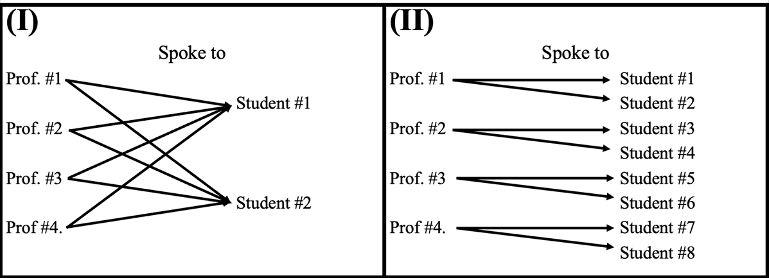
Every professor praised two students.
Two students, every professor praised.
The two “logically possible” interpretations for this sentences.
DR(every professor, two students) reading
Each professor in question praised a different set of two students.
Non-DR reading
The same two students were praised.
Praised
Praised

Slide 27
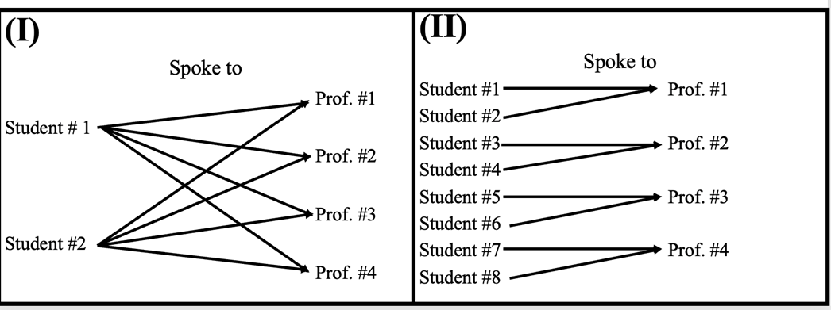
Two students praised every professor.
The two “logically possible” interpretations for this sentences in (I) and (II).
Non-DR reading
The same two students praised every professor.
DR(every professor, two students) reading
Each professor in question was praised by a different set of two students.
Praised
Praised

Slide 28
Coref(X, Y)
X and Y (co-)refer to the same individual/object.

Slide 29


Coref82-2
Schema A1 ( Under the interpretation that "his" refers to John. )
His father, John praised.
Schema B1 ( Under the interpretation that "his" refers to John. )
His father praised John.
Schema C1 ( Under the interpretation that "his" refers to some other person, such as Bill. )
His father praised John.
DR63-15
Schema A1 (Under the interpretation that each teacher in question praised a different set of three students)
Three students, every teacher praised.
Schema B1 (Under the interpretation that each teacher in question was praised by a different set of three students)
Three students praised every teacher.
Schema C1 (Under the interpretation that each teacher in question was praised by the same three students)
Three students praised every teacher.

Slide 30
Revised Hypothesis, generalized to cover DR(X, Y) and Coref(X, Y):
There are three sources for BVA(X, Y).
There are also three sources for DR(X, Y) and for Coref(X, Y):
Three sources for DR(X, Y):
CC(X, Y): X c-commanding Y
XQrk: Quirky (non-c-command-based) source for DR(X, Y) that is crucially based on the choice of X.
YQrk: Quirky (non-c-command-based) source for DR(X, Y) that is crucially based on the choice of Y.
Three sources for Coref(X, Y):
CC(X, Y): X c-commanding Y
XQrk: Quirky (non-c-command-based) source for Coref(X, Y) that is crucially based on the choice of X.
YQrk: Quirky (non-c-command-based) source for Coref(X, Y) that is crucially based on the choice of Y.

Slide 31
DR(X, Y) → CC(X, Y) ˅ XQrk ˅ YQrk
=
¬CC(X, Y) ˄ ¬XQrk ˄ ¬YQrk → ¬DR(X, Y)
DR(X, Y) is impossible without X c-commanding Y, if no XQrk and no YQrk.
Given ¬CC(X, Y) ˄ ¬XQrk ˄ ¬YQrk → ¬DR(X, Y), we take the impossibility of DR(X, Y) as indicating:
X not giving rise to XQrk
Y not giving rise to YQrk

Slide 32
Coref(X, Y) → CC(X, Y) ˅ XQrk ˅ YQrk
=
¬CC(X, Y) ˄ ¬XQrk ˄ ¬YQrk → ¬Coref(X, Y)
Coref(X, Y) is impossible without X c-commanding Y, if no XQrk and no YQrk.
Given ¬CC(X, Y) ˄ ¬XQrk ˄ ¬YQrk → ¬DR(X, Y), we take the impossibility of Coref(X, Y) as indicating:
X not giving rise to XQrk
Y not giving rise to YQrk

Slide 33


Coref82-2
Schema A1 ( Under the interpretation that "his" refers to John. )
His father, John praised.
Schema B1 ( Under the interpretation that "his" refers to John. )
His father praised John.
Schema C1 ( Under the interpretation that "his" refers to some other person, such as Bill. )
His father praised John.
Under Coref(alpha, Y) (e.g., Coref(John, his))
Schema A: Y’s N, X Verb
(E.g., Schema A1: His father, John praised.)
Schema B:
Y’s N Verb X
(E.g., Schema B1: His father praised John.)
This can correspond to the merge-generated set {S, {V, O}}.
‘John’ is the S(ubject), c-commanding his inside the O(bject).
This must correspond to the merge-generated set {S, {V, O}}.
‘John’ is the O(bject), not c-commanding his inside the S(ubject).
Coref82-2:
Schema A can correspond to {John, {praised, {his, father}}.
Schema B must correspond to {{his, father}, {praised, John}}
CC(John, his)
¬CC(John, his)

Slide 34


DR63-15
Schema A1 (Under the interpretation that each teacher in question praised a different set of three students)
Three students, every teacher praised.
Schema B1 (Under the interpretation that each teacher in question was praised by a different set of three students)
Three students praised every teacher.
Schema C1 (Under the interpretation that each teacher in question was praised by the same three students)
Three students praised every teacher.
Under DR(X, beta) (e.g., BVA(every teacher, three students))
Schema A: beta, X Verb
(E.g., Schema A1: Three students, every teacher praised.)
Schema B:
beta Verb X
(E.g., Schema b1: Three students praised every teacher.)
This can correspond to the merge-generated set {S, {V, O}}, where
every teacher is the S(ubject), c-commanding three students in the O(bject).
This must correspond to the merge-generated set {S, {V, O}}, where
every teacher is the O(bject), not c-commanding three students inside the S(ubject).
Coref63-15:
Schema A can correspond to {every teacher, {praised, three students}.
Schema B must correspond to {three students, {praised, every teacher}}
CC(every teacher, three students)
¬CC(every teacher, three students)

Slide 35
Back to Venn Diagrams

Slide 36
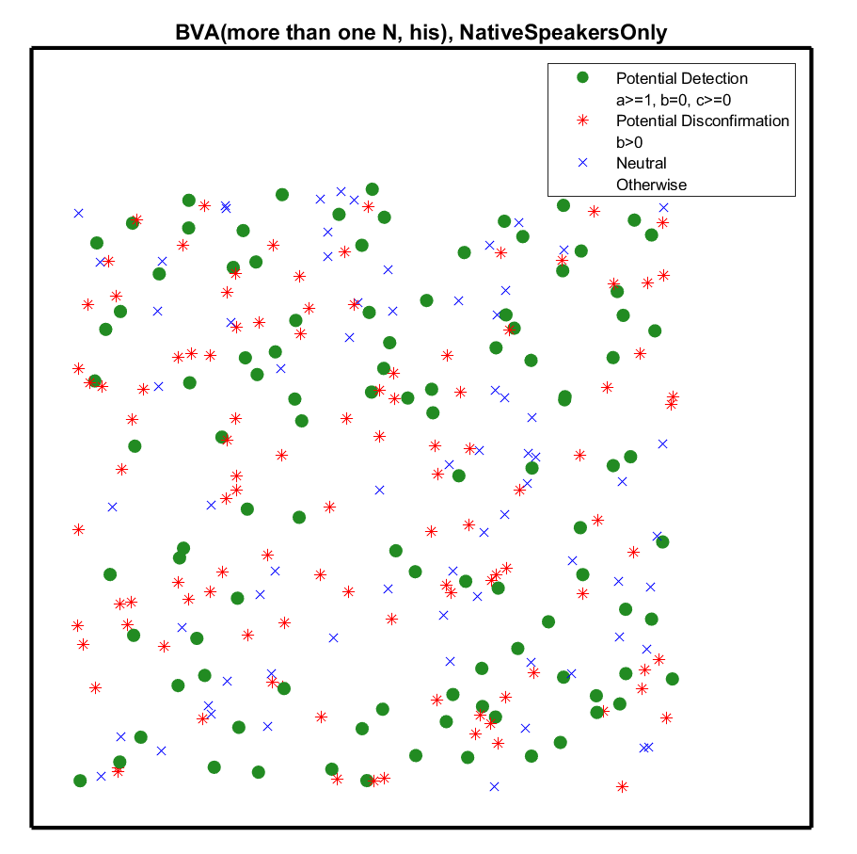






The percentage of the Yes answers among all the answers a speaker gave on sentences of the Schema A type (i.e., Schema A1 and Schema A2).
BVA31-75 BVA(more than one N, his)
%Value(STA) in BVA31-75 = 1 or higher
%Value(STB) in BVA31-75 = 0
*
%Value(STB) in BVA31-75 = 1 or higher
x
%Value(STA) in BVA31-75 = 0
%Value(STB) in BVA31-75 = 0
Each dot represents a speaker, and its color is based on their judgments reported in BVA31-75.
The percentage of the Yes answers among all the answers a speaker gave on sentences of the Schema B type (i.e., Schema B1 and Schema B2).
A participant is allowed to revisit the experiment site as many times as they wish and report their judgments as many times as they wish.

Slide 37
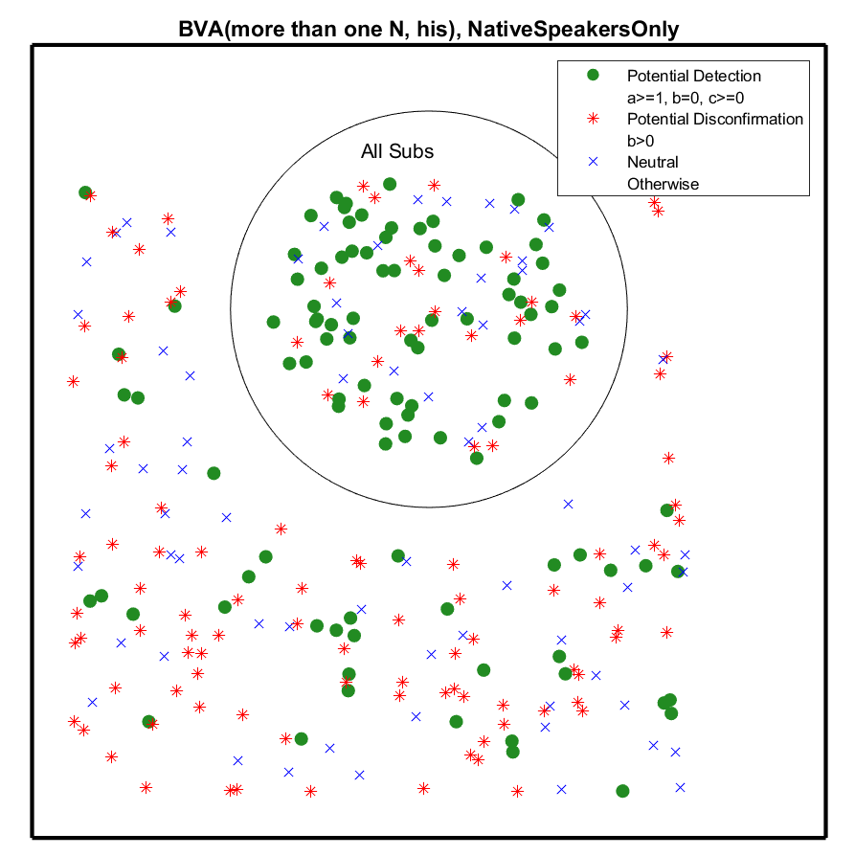
BVA31-75 BVA(more than one N, his)
Those who passed the relevant Subs tests are in this circle.
Sub passing:
For each Sub considered:
%Value(STA) = 1 or higher
%Value(STB) = 0
These values are not based on our (c-command-based) hypothesis discussed earlier; we do not address what hypotheses necessarily lead to “No” (i.e., the %Value(STB) being 0%) on Schema B in Sub-Experiments.

Slide 38
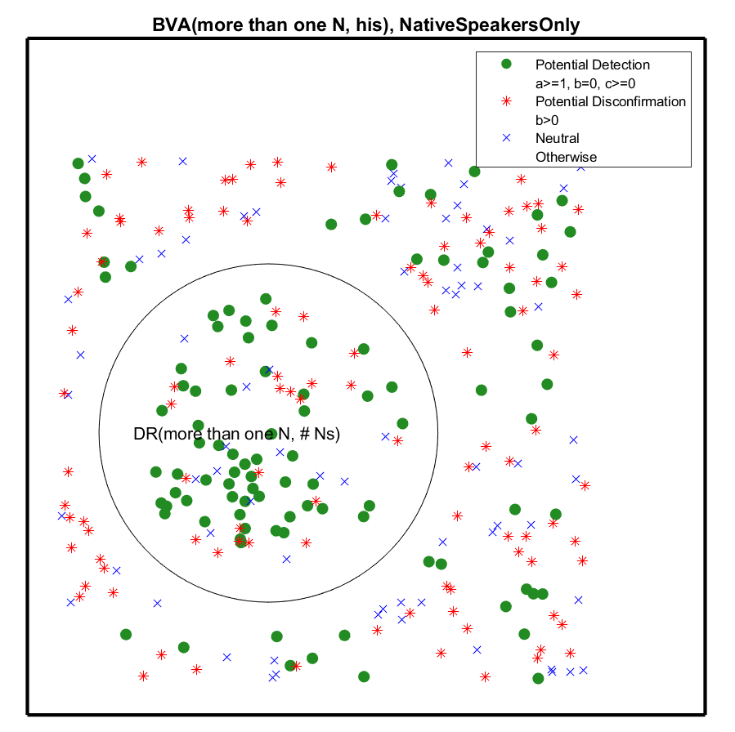


BVA31-75 BVA(more than one N, his)
The point very important.
If you are Green with DR63-19, DR(more than one N, # Ns) (e.g., DR(more than one teacher, three students), you are in this Circle.
Green with DR63-19, DR(more than one N, # Ns):
%Value(STA) in DR63-19 = 1 or higher
%Value(STB) in DR63-19 = 0
DR63-19 is chosen for checking whether we have c-command detection with BVA31-75 because:
DR63-19 (DR(more than one N, # Ns)) share more than one N with BVA(more than one N, his).
The Schema A is of OSV both in DR63-19 and BVA31-75.

Slide 39
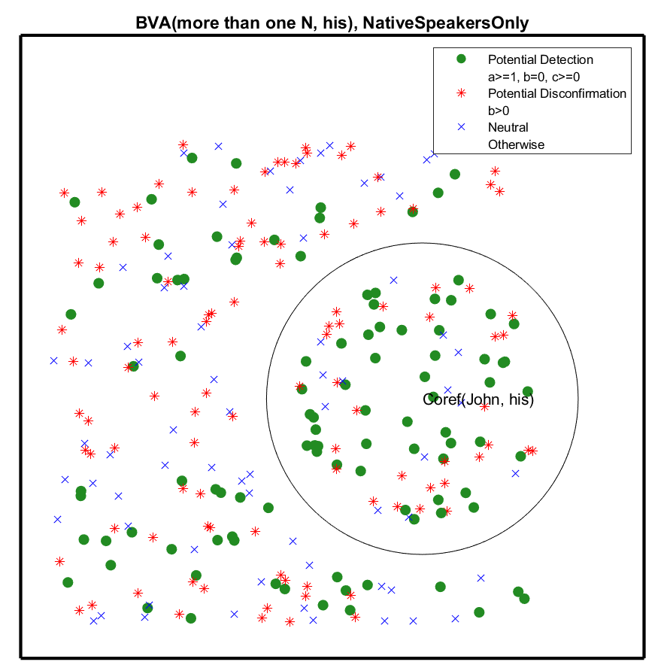


BVA31-75 BVA(more than one N, his)
The point very important.
If you are Green with Coref(John, his), you are in this Circle.
Green: %Value(STA) in Coref82-2 = 1 or higher
%Value(STB) in Coref82-2 = 0
Coref82-2 is chosen for checking whether we have c-command detection with BVA31-75 because:
Coref82-2 (Coref(John, his) share his with BVA(more than one N, his).
The Schema A is of OSV both in Coref82-2 and BVA31-75

Slide 40
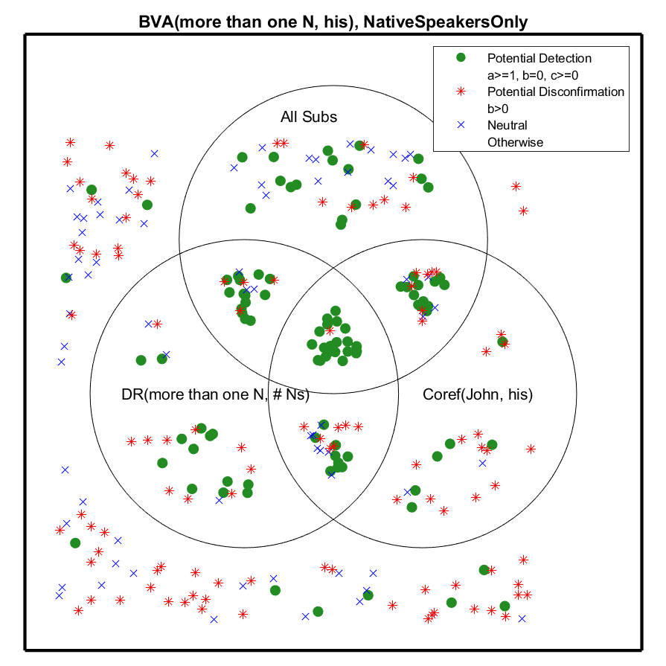
BVA31-75 BVA(more than one N, his)
BVA(X, Y)
A
AB
AC
ABC
BC
B
C
Coref82-2
DR63-19
This is as of 23f, not including results from the subsequent semesters.

Slide 41
By the way, it does not seem to make much of a difference at all whether we only consider native speakers of English or include non-native speakers if we focus on the middle intersection.

Slide 42
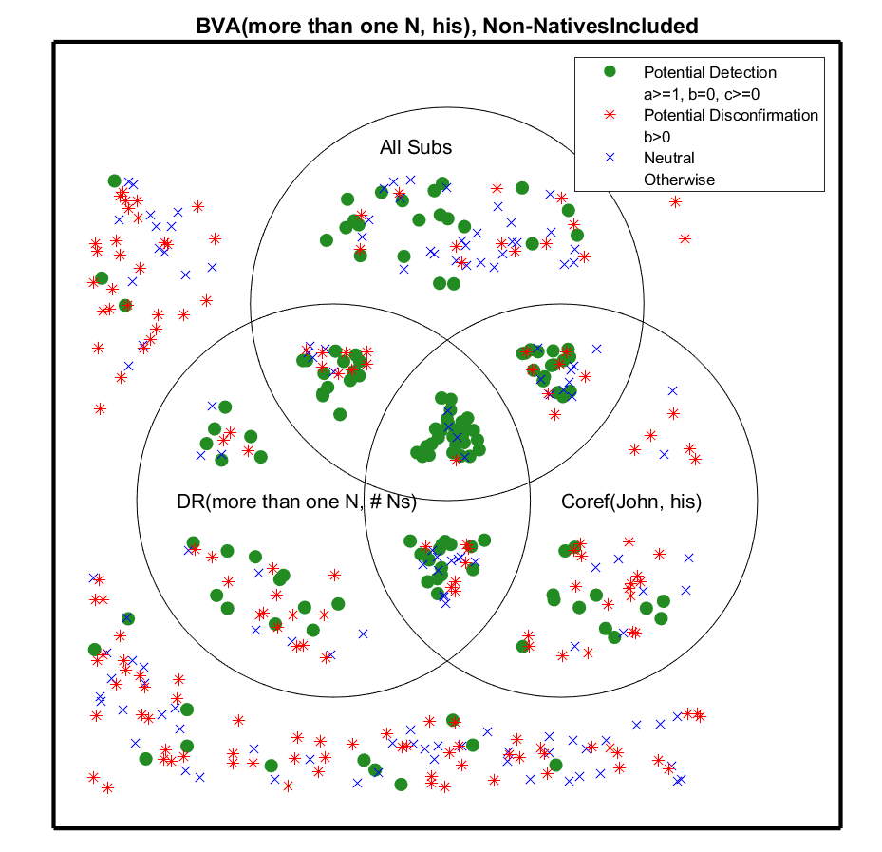
BVA31-75 BVA(more than one N, his), non-native speakers of English included
BVA(X, Y)
A
AB
AC
ABC
BC
B
C
This is as of 23f, not including results from the subsequent semesters.

Slide 43




BVA31-75 BVA(more than one N, his)
DR63-19
Coref82-2

Slide 44
This is not surprising, given that we are investigating universal aspects of the language faculty!

Slide 45
To review

Slide 46
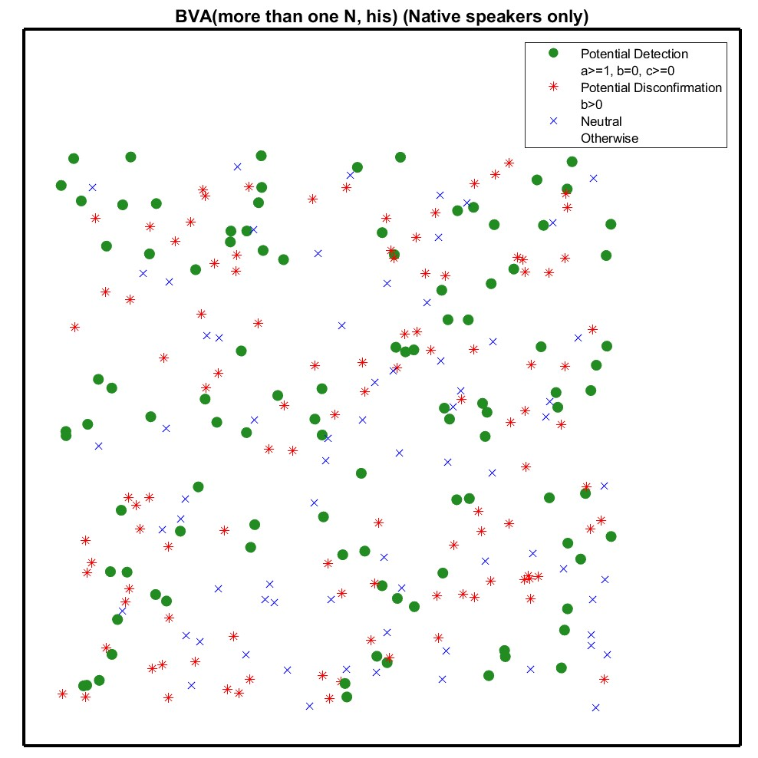

Many Reds stars (potential disconfirmation).
BVA31-75 (=BVA31-80)
Schema B (Under the interpretation "More than one boy was praised by his own father")
His father praised more than one boy

Slide 47
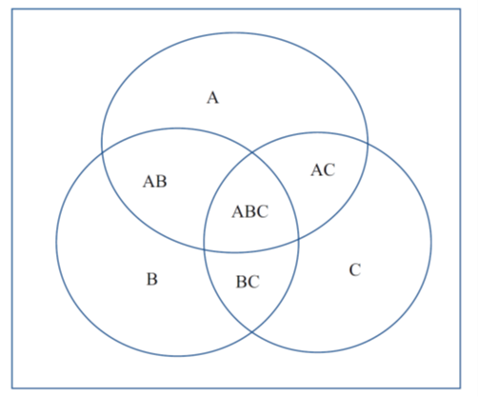
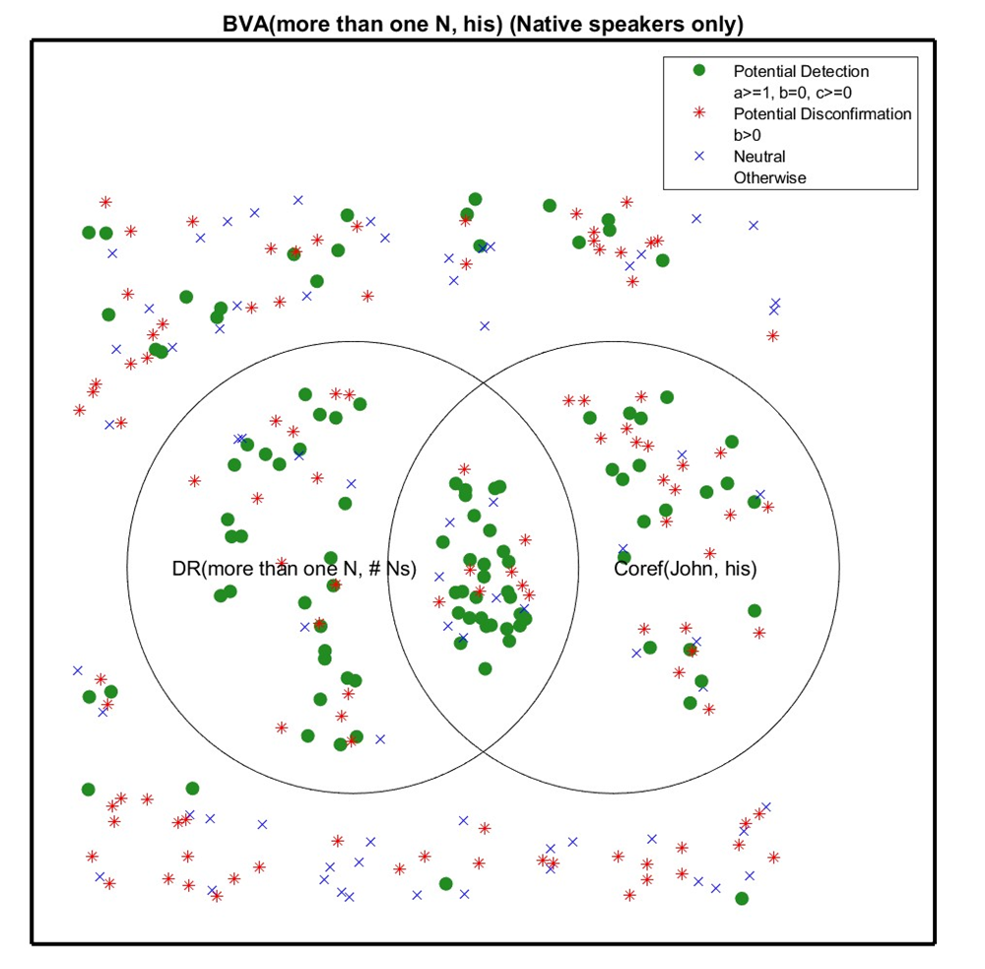


Green with BVA(X, Y) makes a speaker a Green in the Venn Diagram.
Green with DR(X, Y) places a speaker in Circle B.
Green with Coref(X, Y) places a speaker in Circle C.
Green:
%Value(STA) = 1 or higher
%Value(STB) = 0
Red:
%Value(STB) = 1 or higher
(not 0)

Slide 48
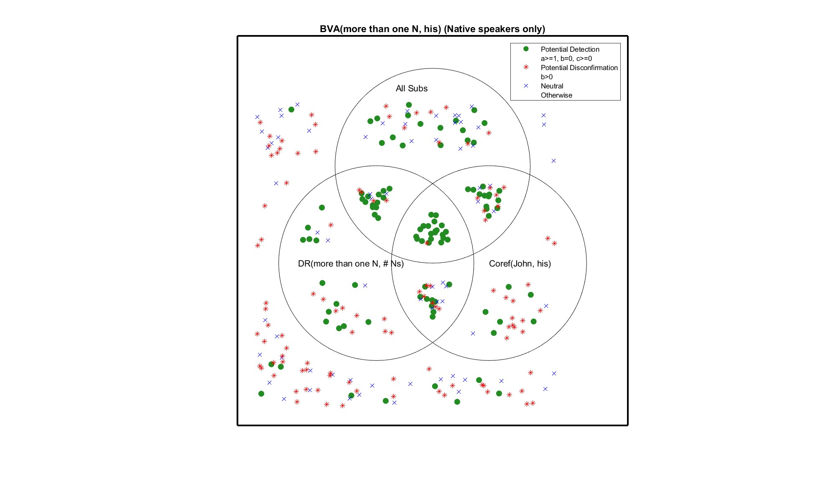

BVA31-75
Those speakers who pass the Subs test are placed in Circle A.

Slide 49












BVA(more than one N, his) BVA31-75 (Green, Red, and Blue in this Venn Diagram are about BVA31-75!)
Circle B: Green in DR63-19 (DR(more than one N, # Ns))
Circle C: Green in Coref82-10 (Coref(Johh, his))
Circle A: Passing all the relevant Subs for “more than one N” (not for “every N”)
BVA31-75

Slide 50
We take X as [-XQrk] for a speaker in ABC because the speaker shows a c-command pattern with DR63-19 (DR(more than one N, # Ns), which includes “never accepting Schema B sentences in DR63-19 (DR(more than one N, # Ns)”.
We take Y as [-YQrk] for a speaker in ABC because the speaker shows a c-command pattern with Coref82-10 (Coref(Johh, his)), which includes “never accepting Schema B sentences in Coref82-10 (Coref(Johh, his))”. See Slide 29.
The speaker passed the Subs tests.
Predictions for such speakers at that time is:
BVA(X, Y) is impossible, with the choices of X and Y in question.

Slide 51


There is one Red * in the middle intersection!
(There is one speaker who accepted BVA(more than one N, his) while showing a c-command pattern with DR(more than one N, #Ns) and a c-command pattern with Coref(John, his), and passing all the relevant Subs tests!)
BVA31-75

Slide 52


Schema Type A
The %Value(STA) is set as “1” for c-command pattern.
What if we change it to “100”, taking a c-command pattern to be based on Schema B:No (never possible, to any extent) and Schema A:Acceptable at least to some extent, 100% of the time, rather than 1% of the time.
The result becomes like this.

Slide 53
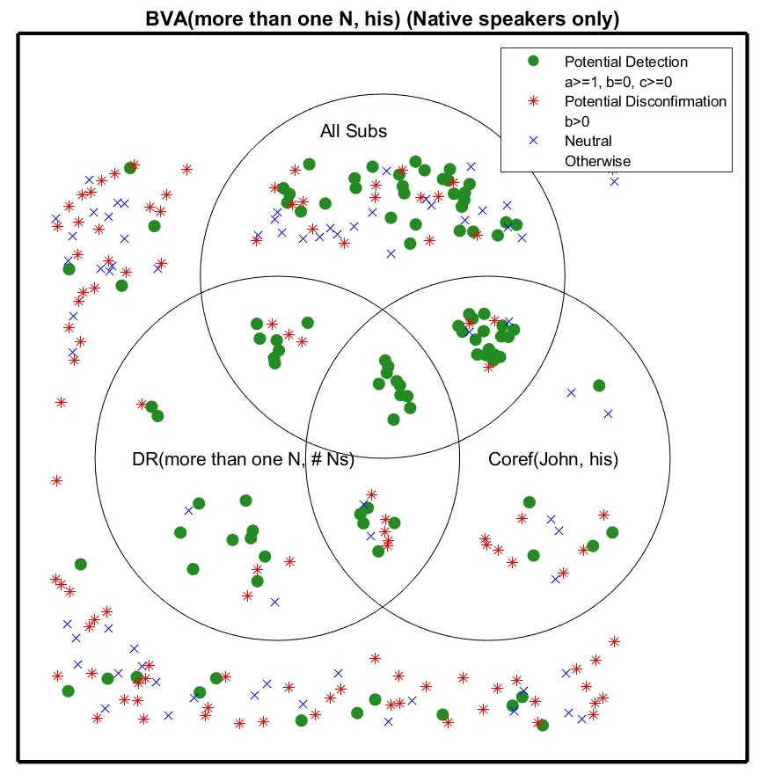

BVA31-75

Slide 54
Having no Red * in the middle intersection is exactly what we have been getting over the years.

Slide 55
Focus on individuals

Slide 56
Since our Venn Diagrams contains many dots, one may get the impression that an experiment is conducted on a group of individuals.
For each individual speaker, we have one of the following 24 Venn Diagrams, as indicated in the next three slides. (8 possibilities about where the speaker is, and 3 possibilities of the speaker’s color (Green, Red, or Blue). 8x3=24.

Slide 58
*
*
*
*
*
*
*
*

Slide 59
x
x
x
x
x
x
x
x

Slide 60
The language faculty is internal to an individual.
Our predictions are, therefore, about an individual.
We make the prediction that if a speaker is in the middle intersection, they are not Red.
If they are Green, that is nice, but we do not predict those in the middle intersection are necessarily Green.
A Venn Diagram with many dots is a composite of many individual Venn Diagrams (24 different types), placed on top of each other!
We deal with individuals!!
Our hypotheses are about individuals and our predictions are about individuals and our experimental results are about individuals.

Slide 61
In the next lecture, we will discuss how replication is further pursued in language faculty science and talk about results of on-line and off-line experiments in languages other than English.

