Slide 1
Language Faculty Science 1
Its object of inquiry
Its method of inquiry

Slide 2
Its object of inquiry is the language faculty.

Slide 3
The language faculty is hypothesized to underlie our ability to relate signs/sounds to meaning.
signs/ sounds
Language Faculty
meaning

Slide 4
The language faculty of an individual is hypothesized to undergo changes due to their linguistic experiences until the initial state (which is hypothesized to be universal among the members of the human species) comes to be its steady states.
Linguistic Experience
Linguistic Experience
Linguistic Experience
Linguistic Experience
Initial State of Lang Faculty
Non-Initial State1 of Lang Faculty
Non-Initial State2 of Lang Faculty
...
Steady State1 of Lang Faculty
...

Slide 5
A steady state of the language faculty (I-language)
Properties due to exposure to linguistic environment
Contributions of its Initial State
Notes:
Ch. 4: p. 118, (2) in The Key Tenets of Language Faculty Science” in The Theory and Practice of Language Faculty Science (2023, De Gruyter Mouton, eds, Hoji, Takubo, and Plesniak).

Slide 6
Language faculty science (LFS) is a study of the language faculty by the basic scientific method.

Slide 7
The basic scientific method is Feynman’s “Guess-Compute-Compare”, as presented in pp. 150-153 of The character of physical law.
Notes:
One of the commonly known names for this is the “hypothetico-deductive method”.

Slide 8
“Guess-Compute-Compare”
=
Hypothesize — Computing consequences of the hypotheses — Comparing the computed consequences (predictions) with experimental result.
If the experimental result differs from the prediction (even very slightly), something must be wrong!
Notes:
To find out what may be wrong,

Slide 9
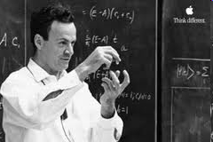
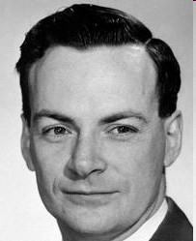
Richard Feynman (1918-1988)

Slide 10
Some Feynman Remarks/Videos

Slide 11
Guess-Compute-Compare
The relevant part
is just this:
0:00-1:02
https://www.youtube.com/watch?v=WQc7-w91mSQ
Notes:
You can watch the whole lecture by visiting https://www.youtube.com/watch?v=WQc7-w91mSQ or any other Feynman video, with a title that contains key words like: Feynman, Seeking New Law, and Messenger Lecture.

Slide 12
Guess-Compute-Compare
“O.K., that is the present situation. Now I am going to discuss how we would look for a new law. In general, we look for a new law by the following process.
First, we guess it.
Then we compute the consequences of the guess to see what would be implied if this law that we guessed is right.
Then we compare the result of the computation to nature, with experiment or experience, compare it directly with observation, to see if it works.
If it disagrees with experiment, it is wrong. In that simple statement is the key to science. It does not make any difference how beautiful your guess is. It does not make any difference how smart you are, who made the guess, or what his name is—if it disagrees with the experiment, it is wrong. That's all there is to it.” (Feynman 1965/94: 150)
Feynman, Richard. 1965/1994. The character of physical law, The Modern Library, New York. (The page references are to the 1994 edition.)

Slide 13
You cannot prove a vague theory wrong.
https://www.youtube.com/watch?v=WQc7-w91mSQ

Slide 14
Importance of Deducing Definite Predictions
This and the next slide are the “transcript” of the relevant part of the preceding video.
"Another thing I must point out is that you cannot prove a vague theory wrong. If the guess that you make is poorly expressed and rather vague, and the method that you use for figuring out the consequences is a little vague—you are not sure, and you say, “I think everything’s right because it’s all due to so and so, and such and such do this and that more or less, and I can sort of explain how this works …”, then you see that this theory is good, because it cannot be proved wrong! " (Feynman 1965/94: 152–153)
Feynman, Richard. 1965/1994. The character of physical law, The Modern Library, New York. (The page references are to the 1994 edition.)

Slide 15
Importance of Deducing Definite Predictions, continued
“By having a vague theory it is possible to get either result. The cure for this one is the following. If it were possible to state exactly, ahead of time, how much love is not enough, and how much love is over-indulgent, then you could make tests. It is usually said when this is pointed out, ‘When you are dealing with psychological matters things can’t be defined so precisely’. Yes, but then you cannot claim to know anything about it.” (Feynman 1965/94: 153)
Feynman, Richard. 1965/1994: p. 153. The character of physical law, The Modern Library, New York. (The page references are to the 1994 edition.)

Slide 16
The main general thesis of the language faculty science research is that it is possible to accumulate knowledge about part of the mind (the language faculty) by the basic scientific method (by the “Guess-Compute-Compare method) (so in a way very much as in physics).
This is a remarkable result if true; very few people in the world know about this!
How “Guess-Compute-Compare” works (or at least, how it is meant to work) in LFS, both at the “Guess-Compute” stage and at the “Compare” stage, is the topic of these slide presentations.

Slide 17
The speaker’s knowledge about the structural ambiguity of ‘unlockable’, for example, is abstract in the sense that we don’t “see” two distinct structures, corresponding to [[un-lock]-able] (“can be unlocked”) and [un-[lock-able]] (not lockable)).
Significantly more abstract are universal aspects of what underlies our ability to relate linguistic sounds/signs to meaning.

Slide 18
Infinite Creativity (= “The Galilean Challenge”, as Chomsky puts it in his essay “The Galilean Challenge”)
Notes:
https://inference-review.com/article/the-galilean-challenge
The next-to-the-last paragraph of The First Day in Galileo’s Dialogue Concerning the Two Chief World Systems, 1967, University of California Press:
“But surpassing all stupendous inventions, what sublimity of mind was his who dreamed of finding means to communicate his deepest thoughts to any other person, though distant by mighty intervals of place and time! Of talking with those who are in India; of speaking to those who are not et born and will not be born for a thousand or ten thousand years; and with what facility, by the different arrangements of twenty characters upon a page!”

Slide 19
Chomsky in “The Galilean Challenge”
“The language faculty of the human brain provides the means to construct a digitally infinite array of structured expressions; each is semantically interpreted as expressing a thought, and each can be externalized by some sensory modality, such as speech.”

Slide 20
How are such structured expressions get constructed?
By the operation Merge.

Slide 21
Chomsky’s solution [to the Galilean challenge (the infinite creativity of language)] is to hypothesize that, somewhere within the language faculty (which, as noted, is just the name for the assemblage of mental modules that allows for the translation between sentences and meaning) there exists a structure-building module. Chomsky calls this structure-building module the “Computational System” (CS), as it takes pre-existing elements and/or pieces of structure and combines them to “compute” larger structures.
“”Language Faculty Science and Physics”” by Hajime Hoji and Daniel Plesniak in The Theory and Practice of Language Faculty Science (2023, De Gruyter Mouton, eds, Hoji, Takubo, and Plesniak, DOI: 10.1515/9783110724790), p. 392
Notes:
The volume is now available at: 10.1515/9783110724790 free of charge.
The revised versions of Chapters 4, 5, and 6 of that volume are available at ResearchGate.
Chapter 4: The key tenets of language faculty science
Chapter 5: Detection of c-command effects
Chapter 6: Replication: Predicted Correlations of Judgments in Japanese

Slide 22
Merge
These structures are formed using an operation that Chomsky calls “Merge”, which is simply a set-building operation that takes two objects and combines them into a set. These elements can be “atomic”, like words, or they can be elements previously built by Merge, giving the CS recursive capabilities; that is, the CS can apply computations to the outputs of its previous computations, meaning that an unbounded number of structures can be built.
“”Language Faculty Science and Physics”” by Hajime Hoji and Daniel Plesniak in The Theory and Practice of Language Faculty Science (2023, De Gruyter Mouton, eds, Hoji, Takubo, and Plesniak), DOI: 10.1515/9783110724790), p. 392
Notes:
The volume is now available at: 10.1515/9783110724790 free of charge.
The revised versions of Chapters 4, 5, and 6 of that volume are available at ResearchGate.
Chapter 4: The key tenets of language faculty science
Chapter 5: Detection of c-command effects
Chapter 6: Replication: Predicted Correlations of Judgments in Japanese

Slide 23
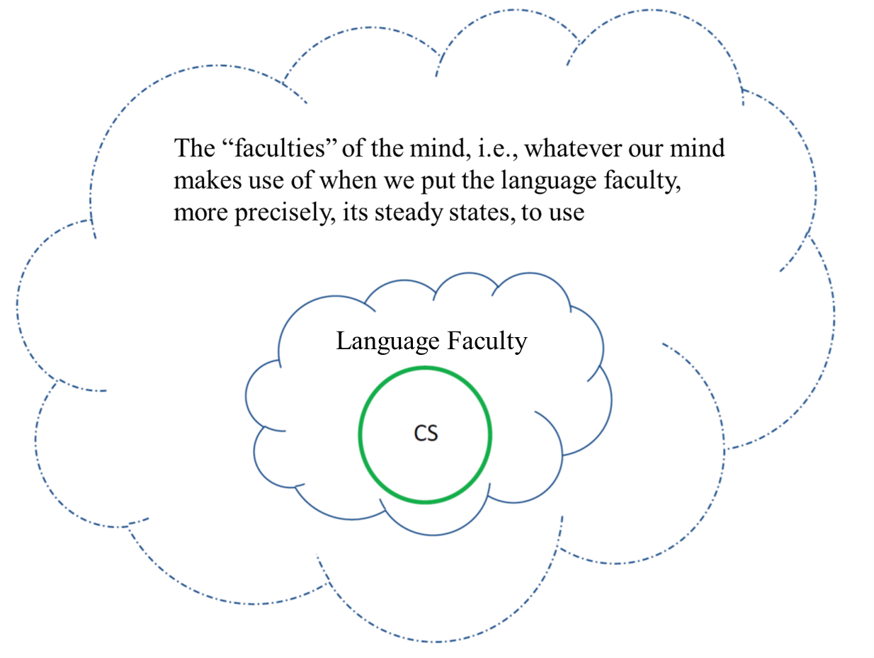
The Computational System (=CS), the language faculty and what is “outside” the language faculty.
Notes:
Based on “Language Faculty Science and Physics” in The Theory and Practice of Language Faculty Science (2023, De Gruyter Mouton, eds, Hoji, Takubo, and Plesniak), p. 218 (106). https://www.researchgate.net/publication/357064262_Chapter_9_Language_faculty_science_and_physics

Slide 24
Simple illustration of Merge
If {eat} and {leaves} merge, it gives us the set {eat, leaves}.
If {iguanas} and {eat, leaves} merge, it gives us {iguanas, {eat, leaves}}.
We understand that Set{iguanas, {eat, leaves}}, generated by repeated application of Merge, expresses a thought that iguanas does the action of eating leaves.

Slide 25
We also understand that Set{leaves, {eat, iguanas}}, which could be generated by repeated application of Merge in a different order (eat and iguanas get merged first, forming {eat, iguana}, then leaves gets merged with this set, forming {leaves, {eat, iguana}}).
That would express an unusual thought that leaves do the action of eating iguanas.

Slide 26
We cannot observe this.
In English, the merge-generated set {iguanas, {eat, leaves}} gets externalized (pronounced) as in:
Iguanas eat leaves (SVO (Subject Verb Object))
In a language like Japanese, it gets externalized as in:
Iguana leaves eat (SOV (Subject Object Verb))
(Using English (instead of Japanese) words here...)
We can observe this.

Slide 27
We hypothesize that in English (also in Japanese), {iguanas, {eat, leaves}} can also get externalized (pronounced) as in:
Leaves, iguanas eat (OSV (Object Subject Verb))

Slide 28
Hypothesized correspondences between merge-generated set and phonetic sequences (SVO (Subject Verb Object)) and OSV (Object Subject Verb) in English):
This is the only hypothesis of this type to be discussed in the initial illustration of language faculty science.
Phonetic Sequence (PS)
Merge-generated Set
SVO
{S, {V, O}}
OSV
??
The content of “??” is suppressed in our current discussion.

Slide 29
Since merge-generated sets only express what element and what other element form a set, and, derivatively, what set is a (proper) subset of what other set, the following two are different ways of expressing the same set.
{Mary, {praised, Bill}}
{Mary, {Bill, praised}}
Also
{{praised, Bill}, Mary}
{{Bill, praised}, Mary}

Slide 30
In this sense, merge-generated sets/structures are qualitatively more abstract than the two structures we may postulate to account for the ambiguity of ‘unlockable’, for example.

Slide 31
C-command

Slide 32
The concept of Merge allows us to define a particular structural relation, which we call c-command.

Slide 33
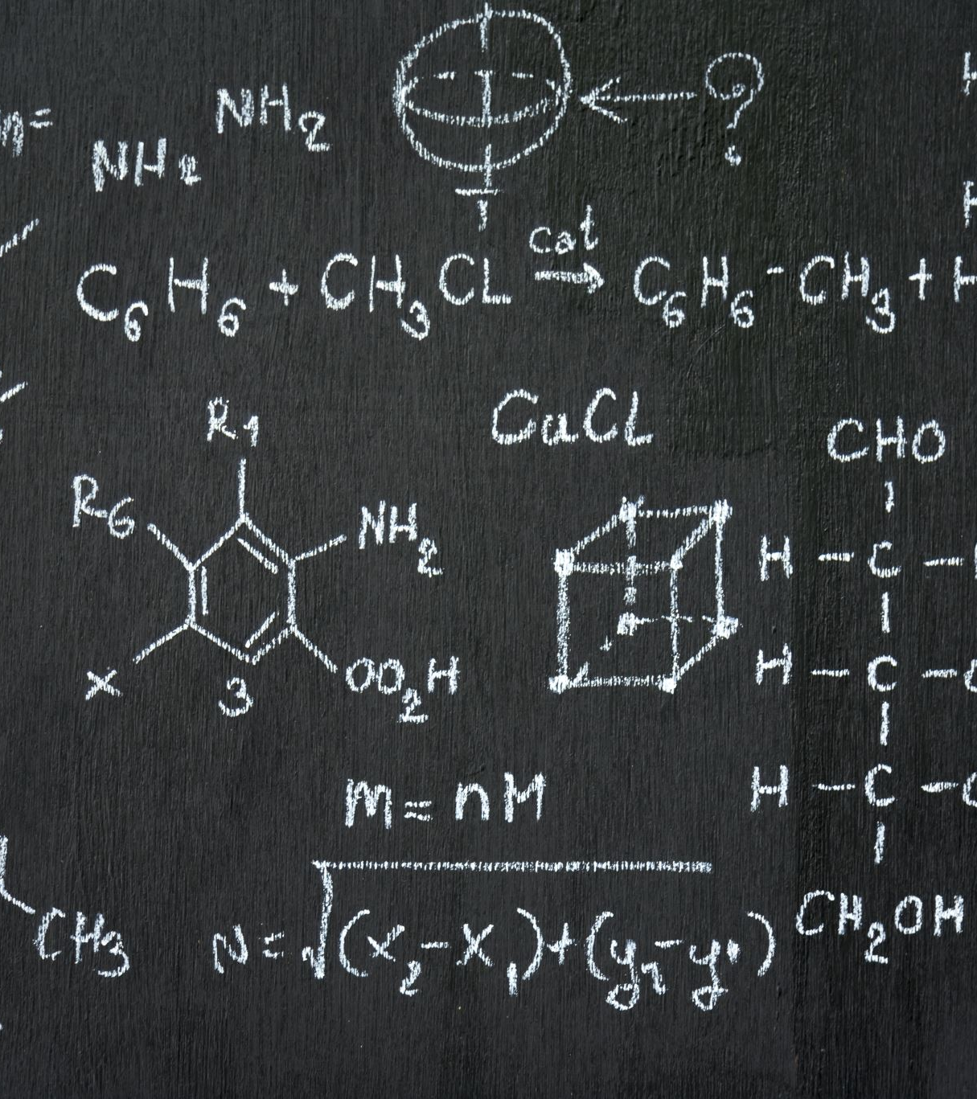
C-command
X c-commands Y
=
X is merged with something that contains Y.
See “Language Faculty Science and Physics”: Section 1.2: p. 394 for what “c-command” “stands for” and brief historical remarks if you are curious. It is not crucial to our discussion here to know that.
Notes:
”Language Faculty Science and Physics”” by Hajime Hoji and Daniel Plesniak in The Theory and Practice of Language Faculty Science (2023, De Gruyter Mouton, eds, Hoji, Takubo, and Plesniak, DOI: 10.1515/9783110724790.
https://www.researchgate.net/publication/357064262_Chapter_9_Language_faculty_science_and_physics

Slide 34
Since Merge is hypothesized to be a universal part of the language faculty, we expect to, at least hope to, observe effects of the structural relation of c-command universally.
With any speaker of any language!

Slide 35
On-line Experiments, to be discussed below, are our attempt to illustrate how we test such an expectation in relation to speakers of English and how we obtain predicted experimental results.

Slide 36
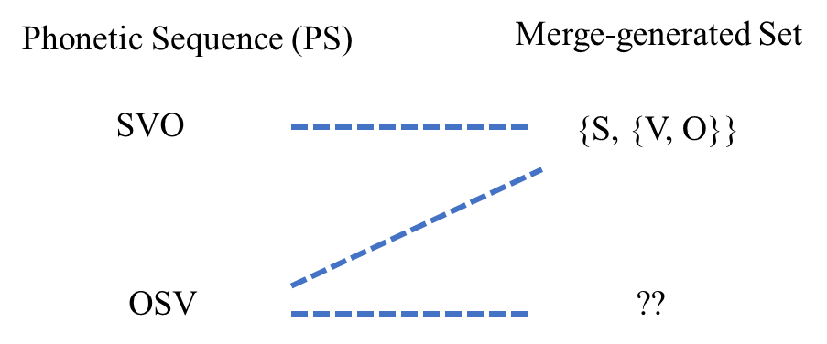
Review Slide
Hypothesis:
Phonetic sequence SVO (Subject Verb Object)) must, and phonetic sequence OSV (Object Subject Verb) can, correspond to the merge-generated set {S, {V, O}}.
X c-commands Y
=
X is merged with something that contains Y

Slide 37
Given our hypotheses, the merge-generated set corresponding to SVO (Subject Verb Object) is {S, {V, O}}, and O does not c-command S because O is merged with V.
For a specific instance of SVO, such as:
(1) [_{S} His father] [_{V} praised] [_{O} every boy]
The merge-generated set corresponding to this is:
{his father, {praised, every boy}}
more precisely:
{{his, father}, {praised,{every boy}}}
even more precisely:
{{his, father}, {praised, {every, boy}}},
every boy merges with praised.
So, every boy does not c-command the S (his father) and it does not c-command his (in a merge-generated set corresponding to the sentence in (1).

Slide 38
OSV (Object Subject Verb) can correspond to {S, {V, O}}, where S c-commands O and what is contained in the O.
For a specific instance of SVO, such as:
(2) [_{O} His father], [_{S} every boy] [_{V} praised]
The merge-generated set corresponding to this can be:
{every boy, {praised, his father}}
more precisely:
{every boy, {praised, {his, father}}}
even more precisely:
{{every, boy}, {praised, {his, father}}},
every boy merges with {praised, {his, father}}.
In this merge-generated set, every boy c-commands the O (his father) and his, contained in the O(bject).

Slide 39
BVA(X, Y)
(e.g., BVA(every boy, his))

Slide 40
If the possibility of BVA(X, Y) requires that X c-command Y, we can check c-command effects based on the possibility and the impossibility of BVA(X, Y).
We can talk about what is meant by BVA(X, Y) in a few different ways.

Slide 41
Pictorially

Slide 42
Every male professor praised his student.
There are two “logically possible” interpretations for this sentence, in relation to the interpretation of his.
42

Slide 43
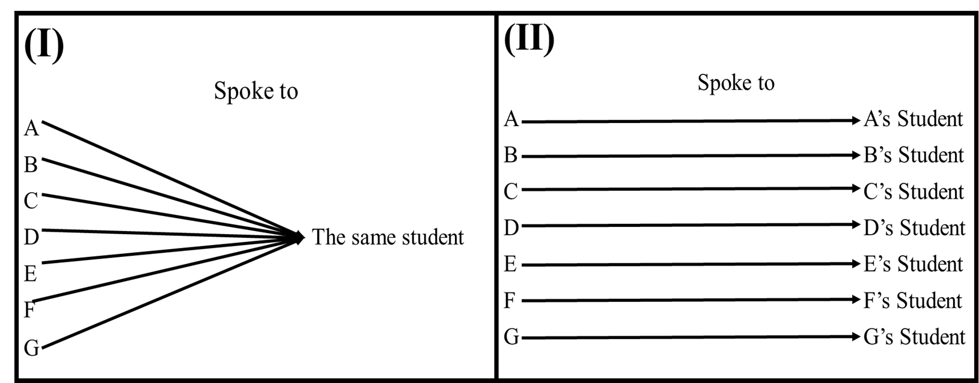
Every male professor praised his student.
The two “logically possible” interpretations for this sentence are:
Non-BVA reading
BVA(every male professor, his)
Different students got praised; each male professor praised his own student.
The same student was praised.
Professors
Professors

Slide 44
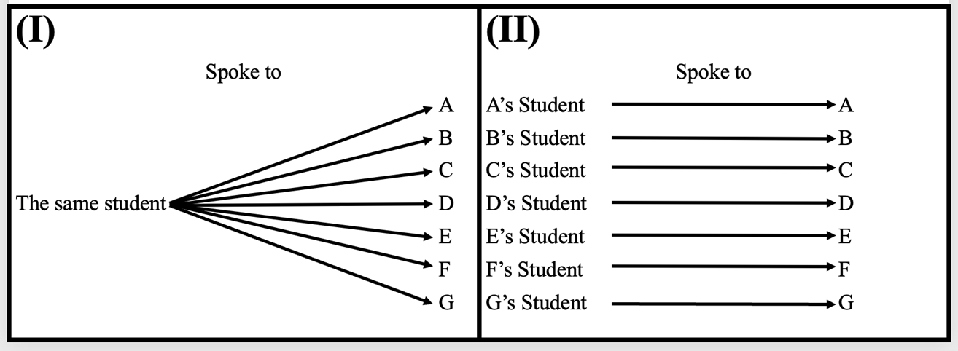
His student praised every male professor.
The two “logically possible” interpretations for this sentence are:
Non-BVA reading
BVA(every male professor, his)
Different students did the praising; every male professor got praised by his own student.
The same student did the praising
Praised
Praised

Slide 45
By “logical notations”

Slide 46
Logically possible BVA(every N, his) interpretations, expressed in “logical notations”:
BVA(every male professor, his) in Every male professor praised his student (SVO) and His student, every male professor praised (OSV) is meant to express:
Every x that is a male professor is such that x praised x’s student.
(For every x, x = a male professor, x praised x’s student.)
BVA(every male professor, his) in His student praised every male professor (SVO) is meant to express:
Every x that is a male professor is such that x’s student praised x.
(For every x, x = a male professor, x’s student praised x.)

Slide 47
Yet another way of expressing BVA(every N, his)

Slide 48
Logically possible BVA(every N, his) interpretations can also be expressed as in:
Whether a speaker actually finds the BVA reading possible in a given sentence is a separate matter. That is what experiments check.
BVA(every male professor, his) in:
Every male professor praised his student (SVO) and
His student, every male professor praised (OSV)
can be expressed as:
The following is true of every male professor:
The male professor in question praised that male professor’s student.
BVA(every male professor, his) in:
His student praised every male professor (SVO)
can be expressed as:
The following is true of every male professor:
The male professor in question’s student praised that male professor.

Slide 49
The initial and simplified hypothesis

Slide 50
The initial and simplified hypothesis:
BVA(X, Y) → CC(X, Y)
(If BVA(X, Y), then necessarily X c-commands Y.)
(X c-commanding Y is a necessary condition for BVA(X, Y)
The above is equivalent to:
¬CC(X, Y) → ¬ BVA(X, Y)
(If X does not c-command Y, BVA(X, Y) is not possible.)
Notation
CC(X, Y): X c-commands Y.
P → Q
is equivalent to:
¬Q → ¬P

Slide 51
When applied to BVA(every boy, his)
Notation
CC(X, Y): X c-commands Y.
The initial and simplified hypothesis, applied to BVA(every boy, his):
BVA(every boy, his) → CC(every boy, his)
(If BVA(every boy, his), then necessarily ‘every boy’ c-commands ‘his’.)
(‘every boy’ c-commanding ‘his’ is a necessary condition for BVA(every boy, his).)
The above is equivalent to:
¬CC (every boy, his) → ¬ BVA(every boy, his))
(If ‘every boy’ does not c-command ‘his’, BVA(every boy, is) is not possible.)
P → Q
is equivalent to:
¬Q → ¬P

Slide 52
Consider the following sentences.
(1) His father, every boy praised.
(2) His father praised every boy.
Can there be a merge-generated set corresponding to (1), where “every boy” c-commands “his”?
Yes.
(1) can correspond to {every boy, {praised, his father}}.
In the merge-generated set corresponding to (2), does “every boy” c-command “his”?
No.
Schema B1 must correspond to {his father, {praised, every boy}}.

Slide 53
The Guess-Compute-Compare method stresses the definite prediction.
Stating exactly how the definite prediction can be disconfirmed is key to any science.
Disconfirmation
=
Obtaining an experimental result that is not exactly in line with the prediction.
Adopting the basic scientific method, we try to make definite predictions that can be disconfirmed “as easily as possible”!

Slide 54
According to our hypothesis about SVO, ‘every boy’ c-commands ‘his’ in the merge-generated set corresponding to:
(1) Every boy praised his father.
but that is not the case for:
(2) His father praised every boy.

Slide 55
We then predict that BVA(every boy, his) is impossible in:
(2) His father praised every boy
and more generally in sentences of the form in:
(3) His Noun Verb every boy
Noun: father, friend, robot, etc.
Verb: praised, criticized, attacked, etc.
And that prediction is disconfirmable!
It will be disconfirmed if a speaker ever finds the BVA(every boy, his) possible in sentences of the form in (3)!

Slide 56
More generally, we predict that BVA(every N, his) is impossible in sentences of the form in (3).
(4) His Noun₁ Verb every Noun₂
Noun₁: father, friend, robot, etc.
Verb: praised, criticized, attacked, etc.
Noun₂: boy, football player, engineer. etc.
And that prediction is disconfirmable!
It will be disconfirmed if a speaker ever finds the BVA(every Noun, his) possible in sentences of the form in (4)!

Slide 57
That is what was claimed in the 1970s.

Slide 58
Many speakers, however, report that they the BVA possible in sentences like His father praised every boy, accepting BVA(every boy, his).

Slide 59
Each “dot” is a speaker who participated in “Experiments” including sentences like:
His father praised every boy.
Red * indicates a speaker who accepted sentences like His father praised every boy under the BVA(every boy, his) interpretation.
We see a lot of them, contrary to the prediction under the initial and simplified hypothesis.
Other details will be addressed later.

Slide 60
One might think that we might get different results if we focused on speakers who are deemed attentive, rather than considering every speaker who participated in “Experiments”.

Slide 61
Even if we focus on the speakers who passed all the relevant Sub-Experiment tests (including those who specifically test the attentiveness of the speaker, we still have a lot of speakers who accept the BVA(every boy, his) interpretation in sentences like His father praised every boy, as seen inside the circle.

Slide 62
In the next lecture, we will modify the initial hypothesis and discuss how we obtain experimental results precisely in line with definite predictions under the revised hypothesis (in the spirit of the Guess-Compute-Compare method).

